Slide 1
One-Step Model Predictive Path Integral for Manipulator Motion
Planning Using Configuration Space Distance Fields
Abstract: Motion planning for robotic manipulators is a fundamental problem in robotics. Classical optimization-based methods typically rely on the gradients of signed distance fields (SDF) to impose collision-avoidance constraints. However, these methods are susceptible to local minima and may fail when the SDF gradients vanish. Recently, Configuration Space Distance Fields (CDF) have been introduced, which directly model distances in the robot’s configuration space. Unlike workspace SDF, CDF are differentiable almost everywhere and thus provide reliable gradient information. On the other hand, gradient-free approaches such as Model Predictive Path Integral (MPPI) control leverage long-horizon rollouts to achieve collision avoidance. While effective, these methods are computationally expensive due to the large number of trajectory samples, repeated collision checks, and the difficulty of designing cost functions with heterogeneous physical units. In this paper, we propose a framework that integrates CDF with MPPI to enable direct navigation in the robot’s configuration space. Leveraging CDF gradients, we unify the MPPI cost in configuration space and reduce the horizon to one step, substantially cutting computation while preserving collision avoidance in practice. We demonstrate that our approach achieves nearly 100% success rates in 2D environments and consistently high success rates in challenging 7-DOF Franka manipulator simulations with complex obstacles. Furthermore, our method attains control frequencies exceeding 750 Hz, substantially outperforming both optimization-based and standard MPPI baselines. These results highlight the effectiveness and efficiency of the proposed CDF-MPPI framework for high dimensional motion planning.
Yulin LI
Supervisor: Kenji Kawashima
Notes:
The motion planning problem is one of the fundamental issues in robotic arm research. The basic problem description involves how to move the end-effector of the robotic arm from the starting position to a specified target position while satisfying various constraints, such as velocity limits or obstacle avoidance requirements. This problem is relevant not only for rigid robotic arms but also for soft robotic arms.

Slide 2
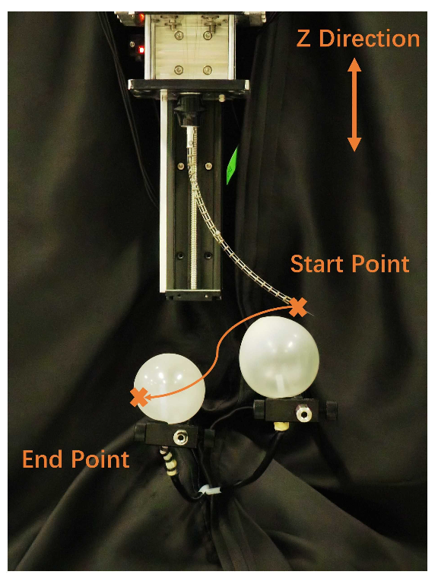
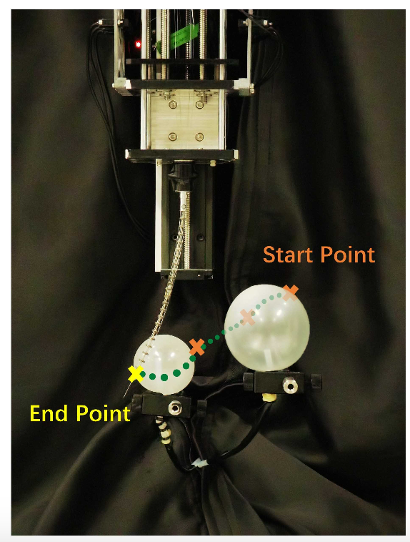
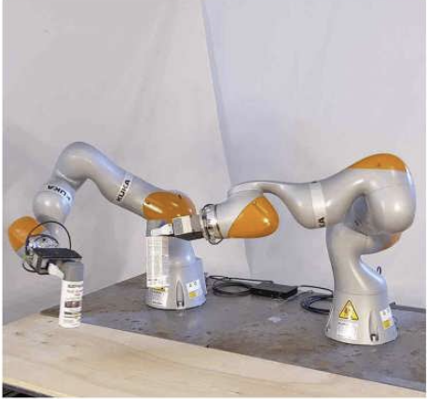
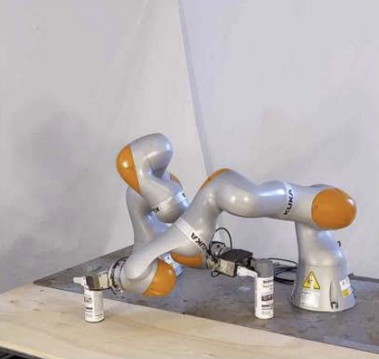
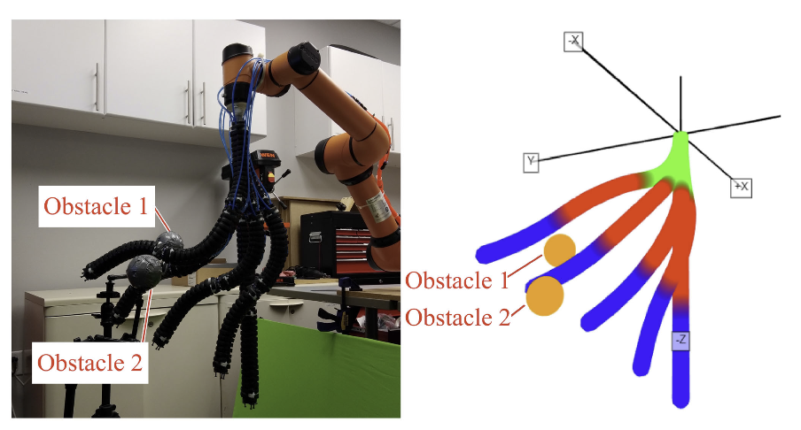
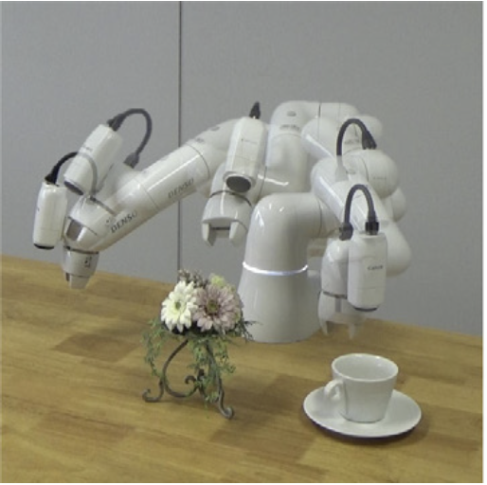
Introduction
Peiyu Luo, ICRA, 2024
Tobia Marcucci, Science Robotics, 2023
Takayuki Osa, IJRR, 2022
Brandon H. Meng, RA-L, 2022
Notes:
The motion planning problem is one of the fundamental issues in robotic arm research. The basic problem description involves how to move the end-effector of the robotic arm from the starting position to a specified target position while satisfying various constraints, such as velocity limits or obstacle avoidance requirements. This problem is relevant not only for rigid robotic arms but also for soft robotic arms.

Slide 3
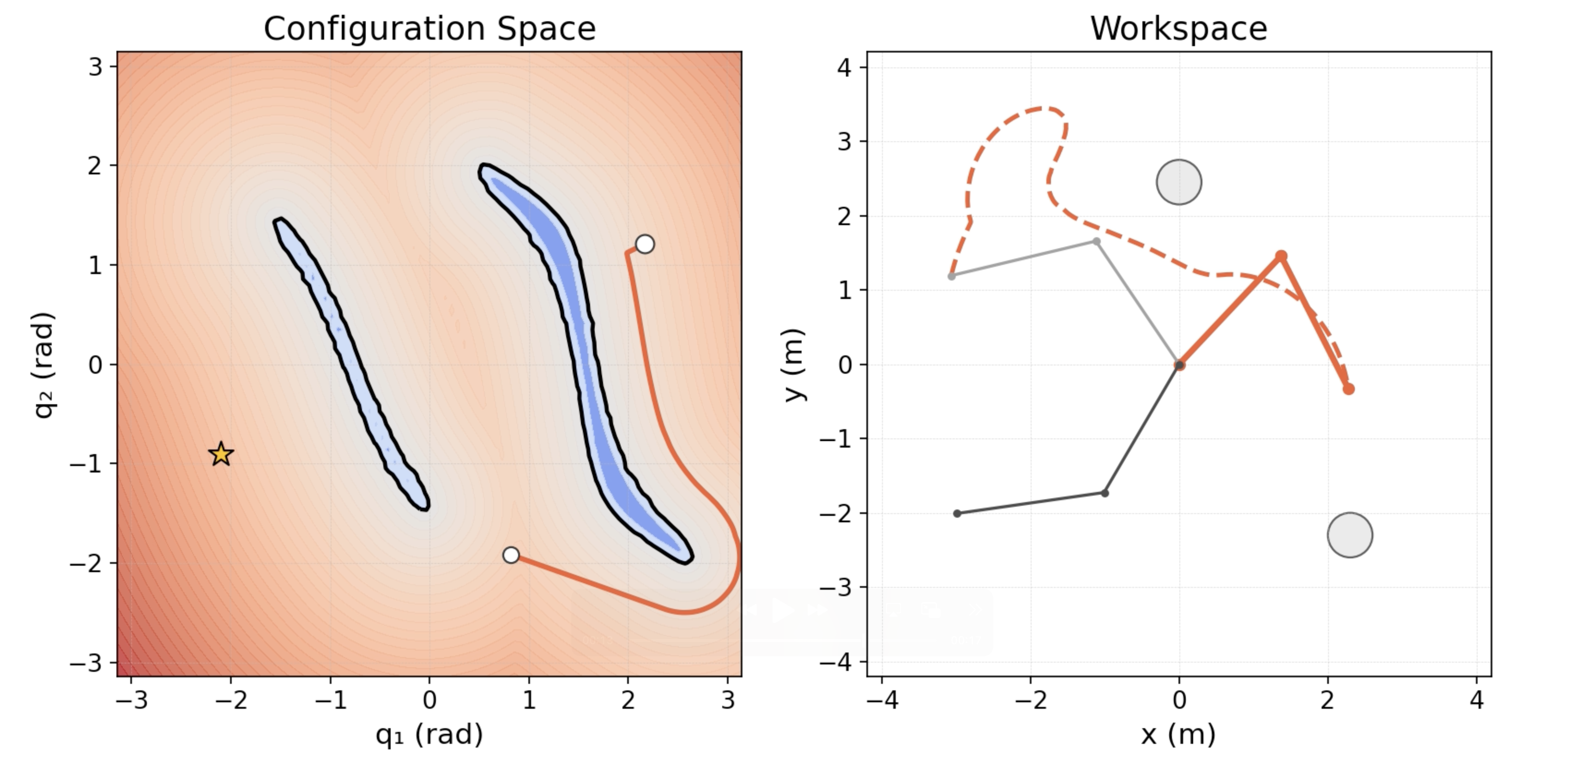
Introduction
Goal: Research path planning directly in the configuration space, which transfer into motion planning in the workspace space of the robot.
Notes:
The motion planning problem is one of the fundamental issues in robotic arm research. The basic problem description involves how to move the end-effector of the robotic arm from the starting position to a specified target position while satisfying various constraints, such as velocity limits or obstacle avoidance requirements. This problem is relevant not only for rigid robotic arms but also for soft robotic arms.

Slide 4
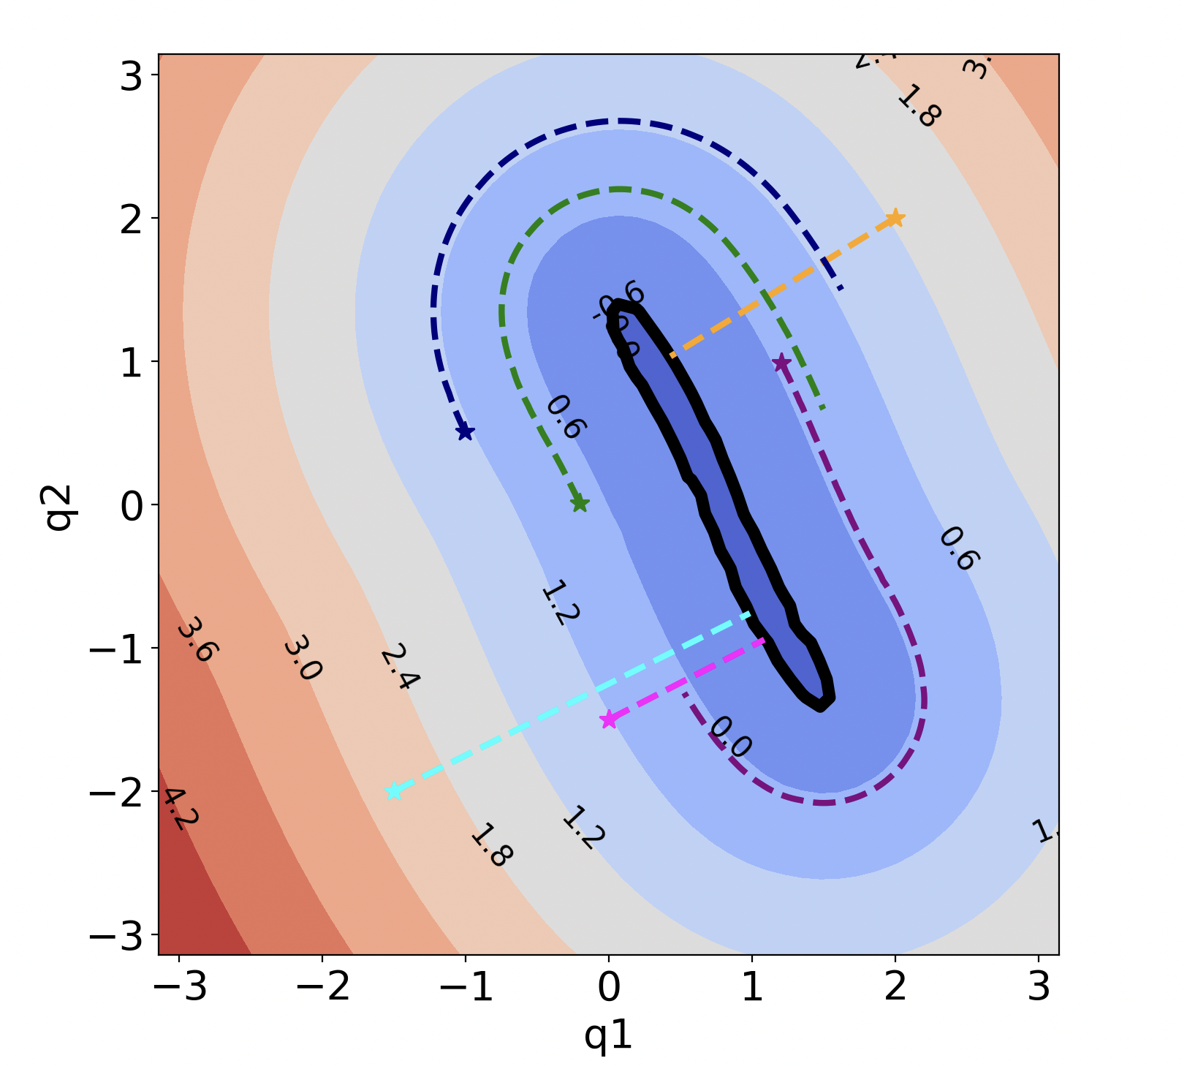
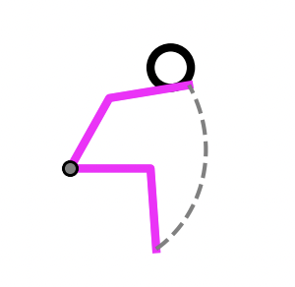
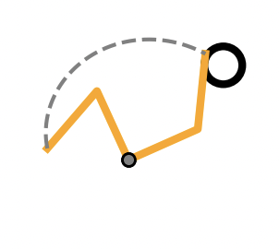
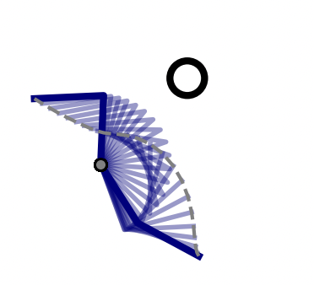
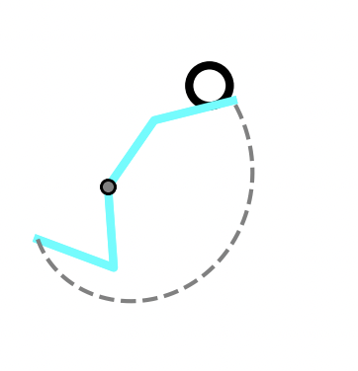
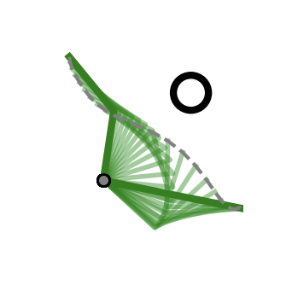
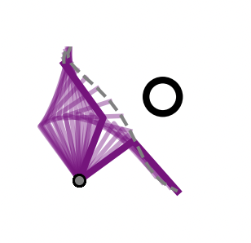
Realted Work
Configuration Space distance field (CDF)
Configuration Space
Work Space
Yiming Li, RSS, 2024
CDF directly models the distance field in the robot’s configuration space
The minimum distance between the manipulator and obstacles.
The gradient of that distance.
Notes:
The motion planning problem is one of the fundamental issues in robotic arm research. The basic problem description involves how to move the end-effector of the robotic arm from the starting position to a specified target position while satisfying various constraints, such as velocity limits or obstacle avoidance requirements. This problem is relevant not only for rigid robotic arms but also for soft robotic arms.

Slide 5
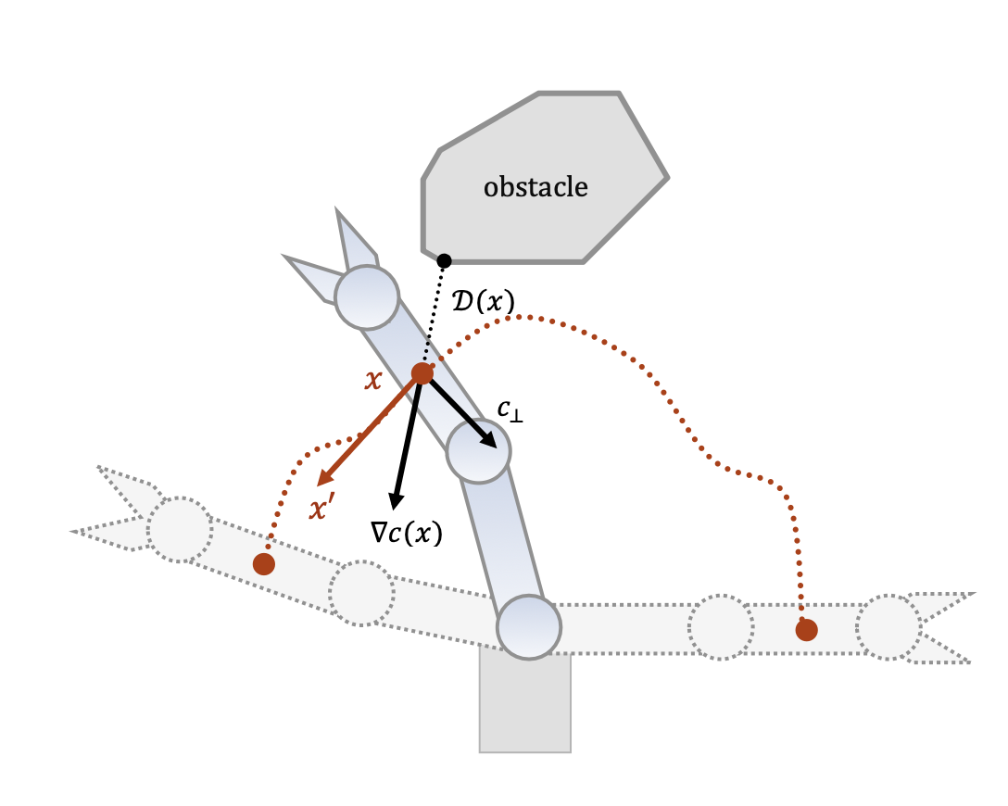
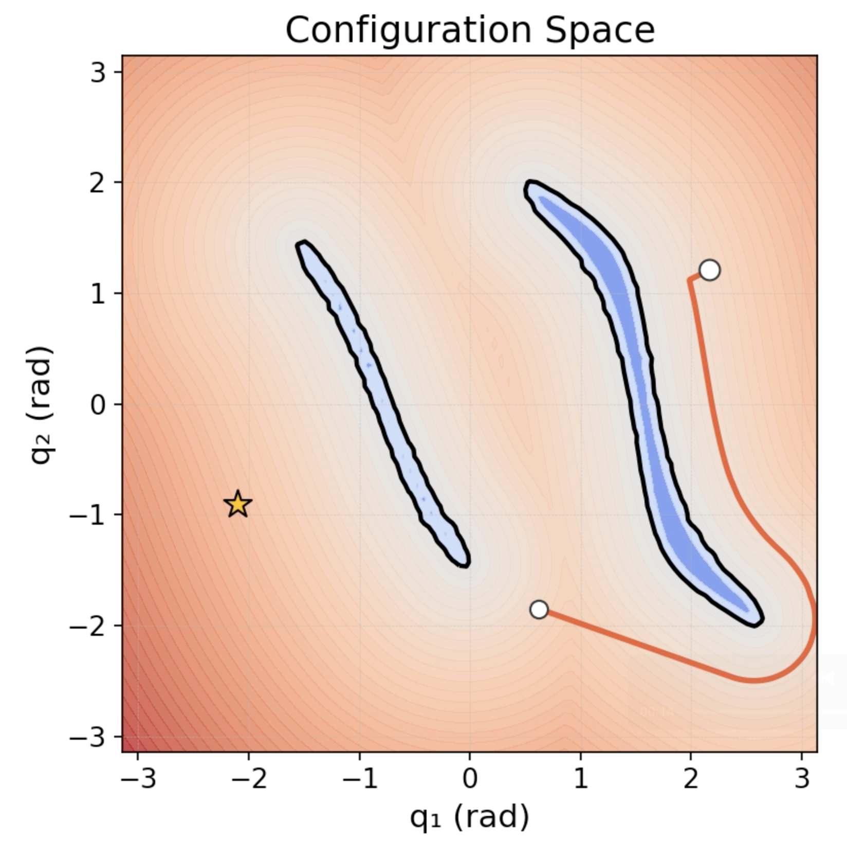
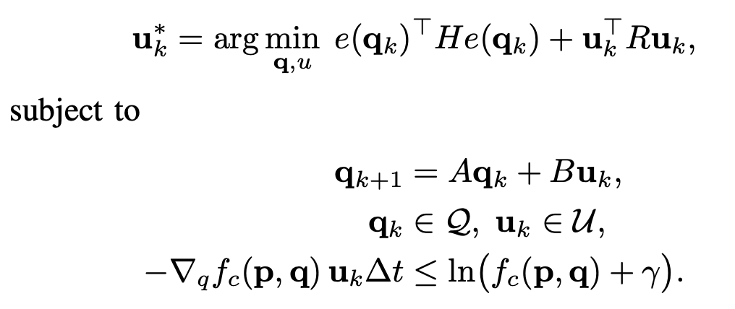
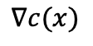
Problem
Optimization based motion planning method
Formulate the motion planning as a quadratic optimization problem:
End-posture error minimization
$$∇c(x)$$
Dynamic constraint
Joint limit
Obs avoidance
Matt Zucker, IJRR, 2013
Gradient information in CDF
Fastest direction away from obstacles
Motion planning is inherently non-convex. Optimization formulation approximates it as convex. This simplification may result in local optimal solutions.
Notes:
The motion planning problem is one of the fundamental issues in robotic arm research. The basic problem description involves how to move the end-effector of the robotic arm from the starting position to a specified target position while satisfying various constraints, such as velocity limits or obstacle avoidance requirements. This problem is relevant not only for rigid robotic arms but also for soft robotic arms.

Slide 6
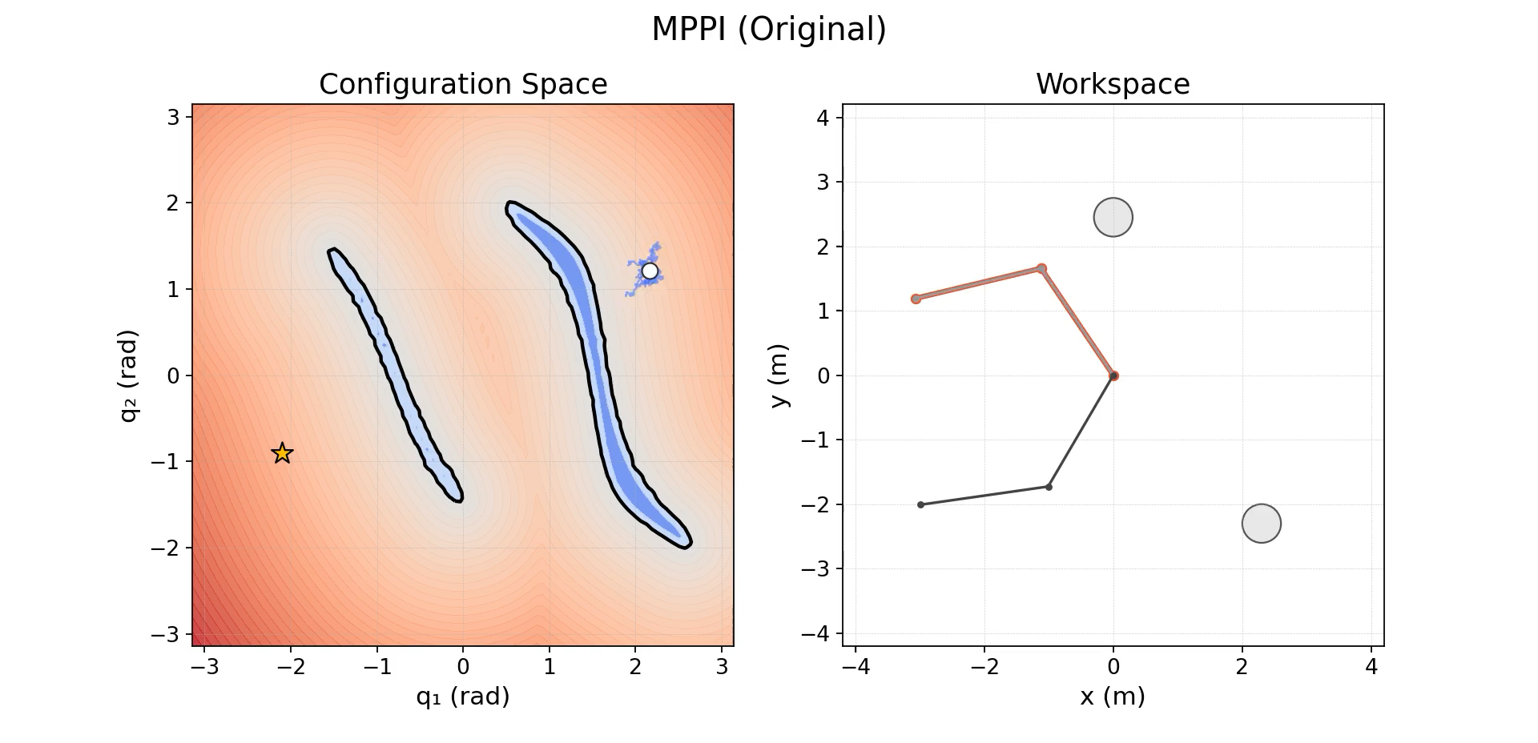
Realted Work
Model Predictive Path Integral (MPPI)
MPPI is a sampling-based control method that updates the action distribution by evaluating the cost of sampled trajectories.
Notes:
The motion planning problem is one of the fundamental issues in robotic arm research. The basic problem description involves how to move the end-effector of the robotic arm from the starting position to a specified target position while satisfying various constraints, such as velocity limits or obstacle avoidance requirements. This problem is relevant not only for rigid robotic arms but also for soft robotic arms.

Slide 7
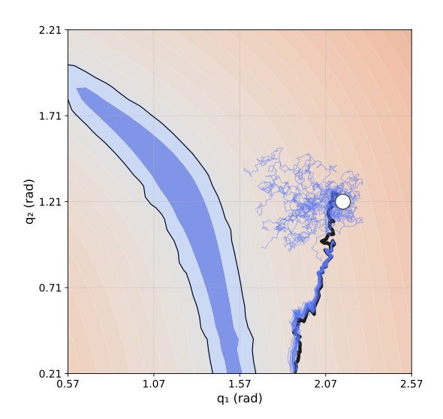
Problem
Model Predictive Path Integral (MPPI)
Main flow:
Sample many control sequences from the current state.
Roll out trajectories under system dynamics.
Evaluate cumulative cost of each trajectory (obstacles, goal, joint limit, manipulability etc.).
Compute an exponential weighted average, favoring low-cost trajectories.
Apply the first control step, then repeat in a receding horizon manner.
Problem:
At each step, N trajectories are sampled, and each trajectory has a length of H, making the overall computation time long.
The cost function units are inconsistent, and the collision detection within the cost function is time-consuming.
Trajectory cost : alpha1 * obstacles collision(+1 collision else 0) + alpha2 * joint limit (rad) + alpha3 * goal(m) + alpha4 * manipulability(None)
Notes:
The motion planning problem is one of the fundamental issues in robotic arm research. The basic problem description involves how to move the end-effector of the robotic arm from the starting position to a specified target position while satisfying various constraints, such as velocity limits or obstacle avoidance requirements. This problem is relevant not only for rigid robotic arms but also for soft robotic arms.

Slide 8
Method
One-Step Model Predictive Path Integral for Manipulator Motion
Planning Using Configuration Space Distance Fields
Problem
Proposed
Optimization-based method
Uses gradient information
Transforms non-convex → convex, causing local optima
Sampling-based method (MPPI)
No gradient used
Simulates many future trajectories → computationally expensive
Cost units inconsistent, difficult to tune
Utilize the gradient information provided by the CDF to simplify the cost function of MPPI.
Notes:
The motion planning problem is one of the fundamental issues in robotic arm research. The basic problem description involves how to move the end-effector of the robotic arm from the starting position to a specified target position while satisfying various constraints, such as velocity limits or obstacle avoidance requirements. This problem is relevant not only for rigid robotic arms but also for soft robotic arms.

Slide 9
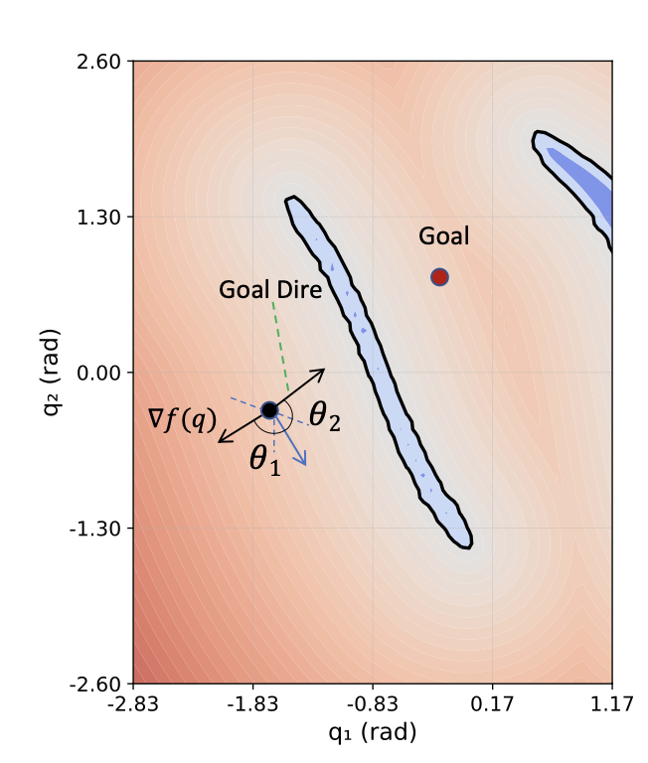
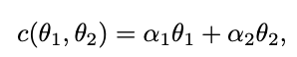
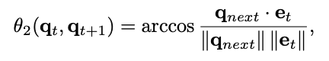
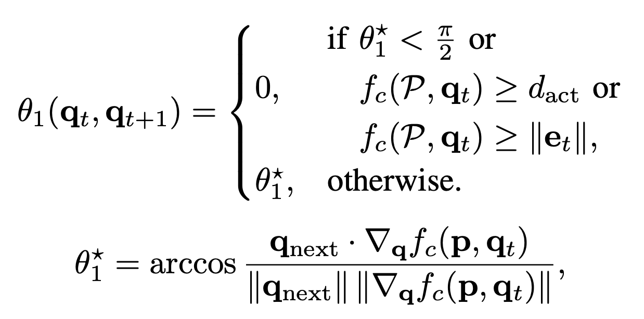
Method
1. Improved Model Predictive Path Integral with an Angle Based Cost Function
Our loss function is based on a simple idea:
1. Penalize states that are close to obstacles or far from the goal.
2. Encourage states that stay away from obstacles and move closer to the goal.
The system is not directed toward the obstacle if the angle is less than 90°.
Notes:
The motion planning problem is one of the fundamental issues in robotic arm research. The basic problem description involves how to move the end-effector of the robotic arm from the starting position to a specified target position while satisfying various constraints, such as velocity limits or obstacle avoidance requirements. This problem is relevant not only for rigid robotic arms but also for soft robotic arms.

Slide 10
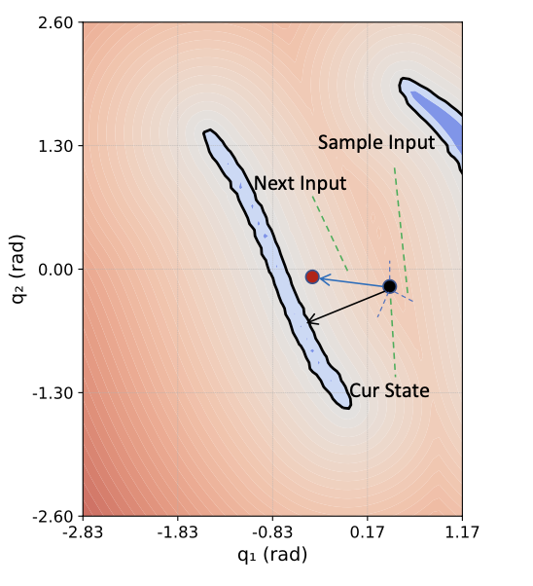
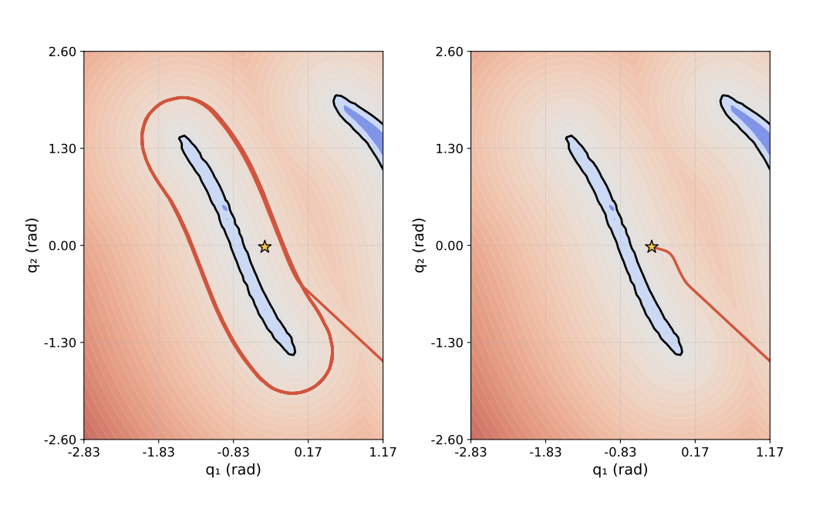
Method
1. Improved Model Predictive Path Integral with an Angle Based Cost Function
1. Not need to avoid obstacle when system is far away from obstacle.
2. When the system is closer to the goal than to the obstacle, it can move directly to the goal.
Without
With
Notes:
CDF is a method for directly constructing a distance field in the configuration space. It provides smooth gradients and fast computation, allowing us to efficiently obtain the minimum distance between a point in the joint space and obstacles within that space.

Slide 11
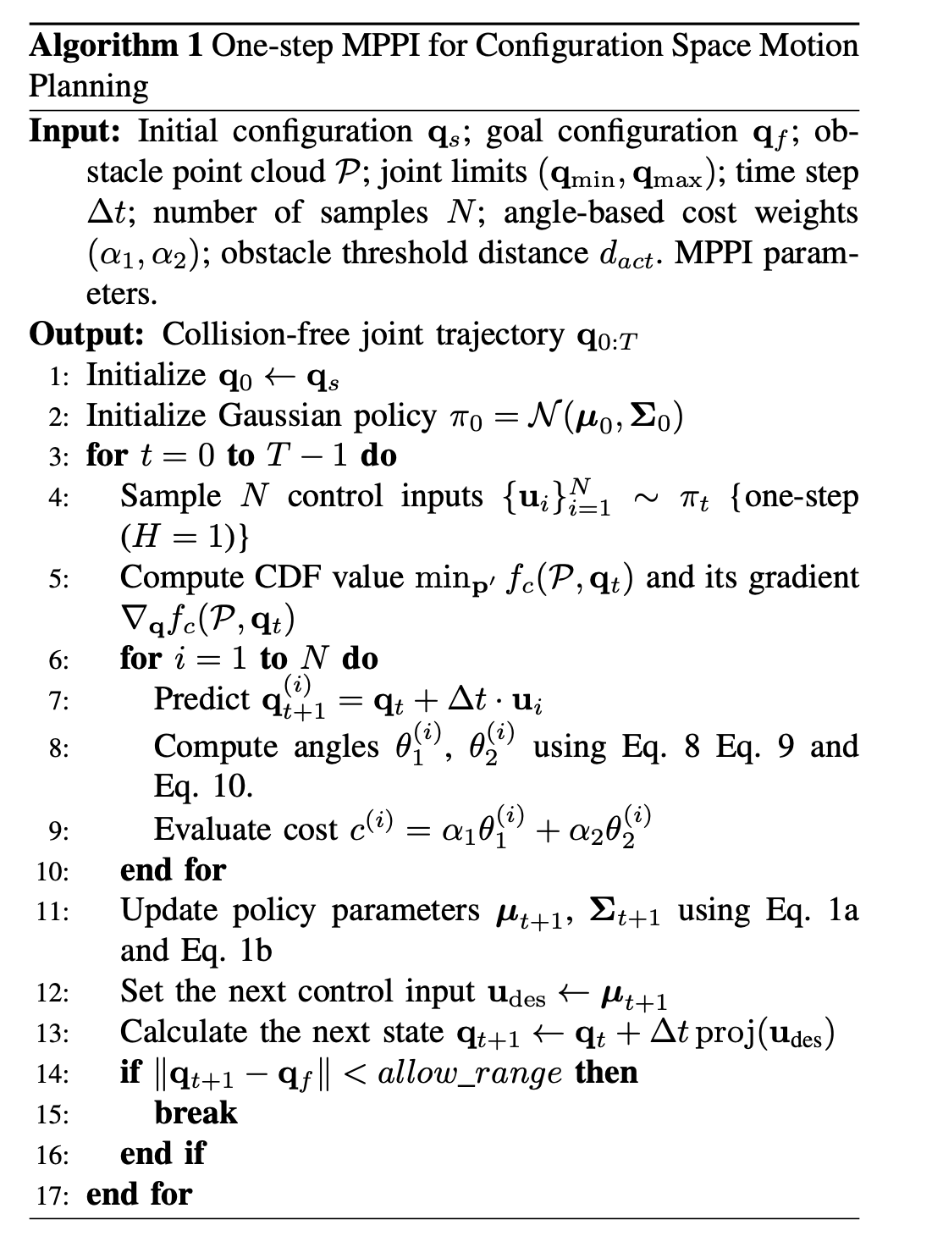
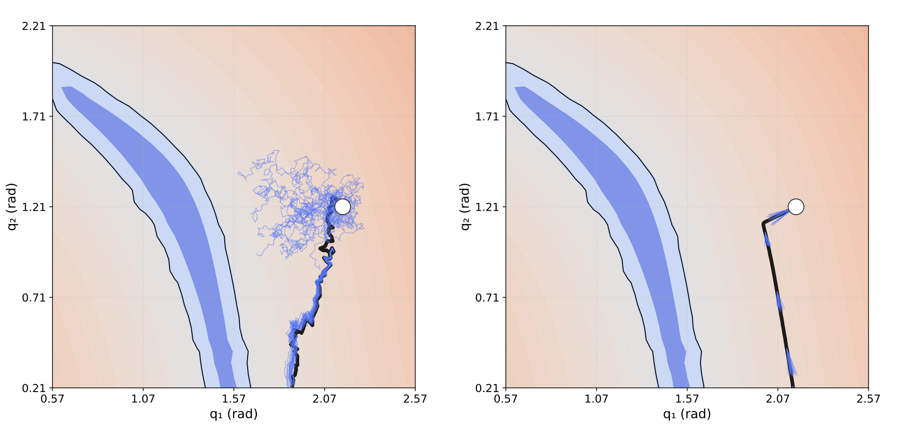
Method
2. One-step MPPI for Configuration Space Motion Planning
To handle the joint limit:
Project the input into the feasiable set.
MPPI (Original)
MPPI (Ours)
Notes:
CDF is a method for directly constructing a distance field in the configuration space. It provides smooth gradients and fast computation, allowing us to efficiently obtain the minimum distance between a point in the joint space and obstacles within that space.

Slide 12
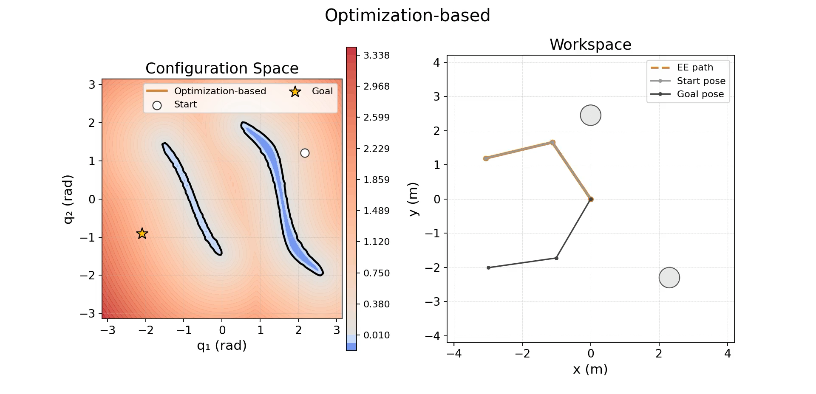
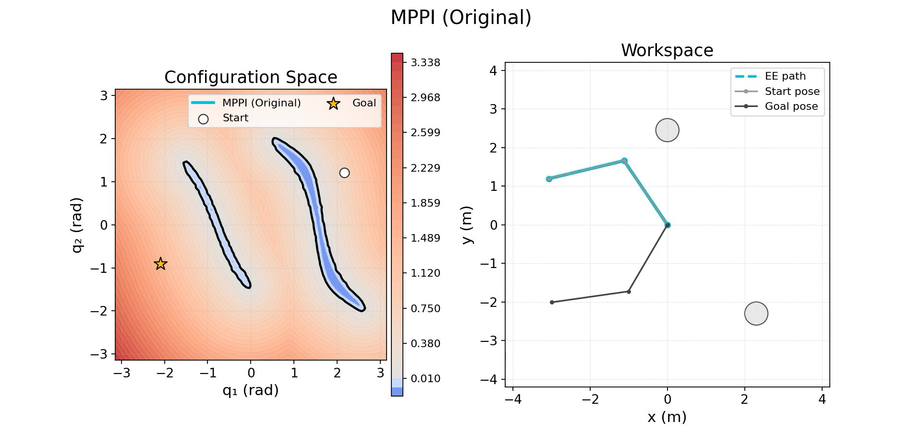
Experimental (2-DoF link robot)
Optimization-based method
MPPI (Original)
Notes:
CDF is a method for directly constructing a distance field in the configuration space. It provides smooth gradients and fast computation, allowing us to efficiently obtain the minimum distance between a point in the joint space and obstacles within that space.

Slide 13
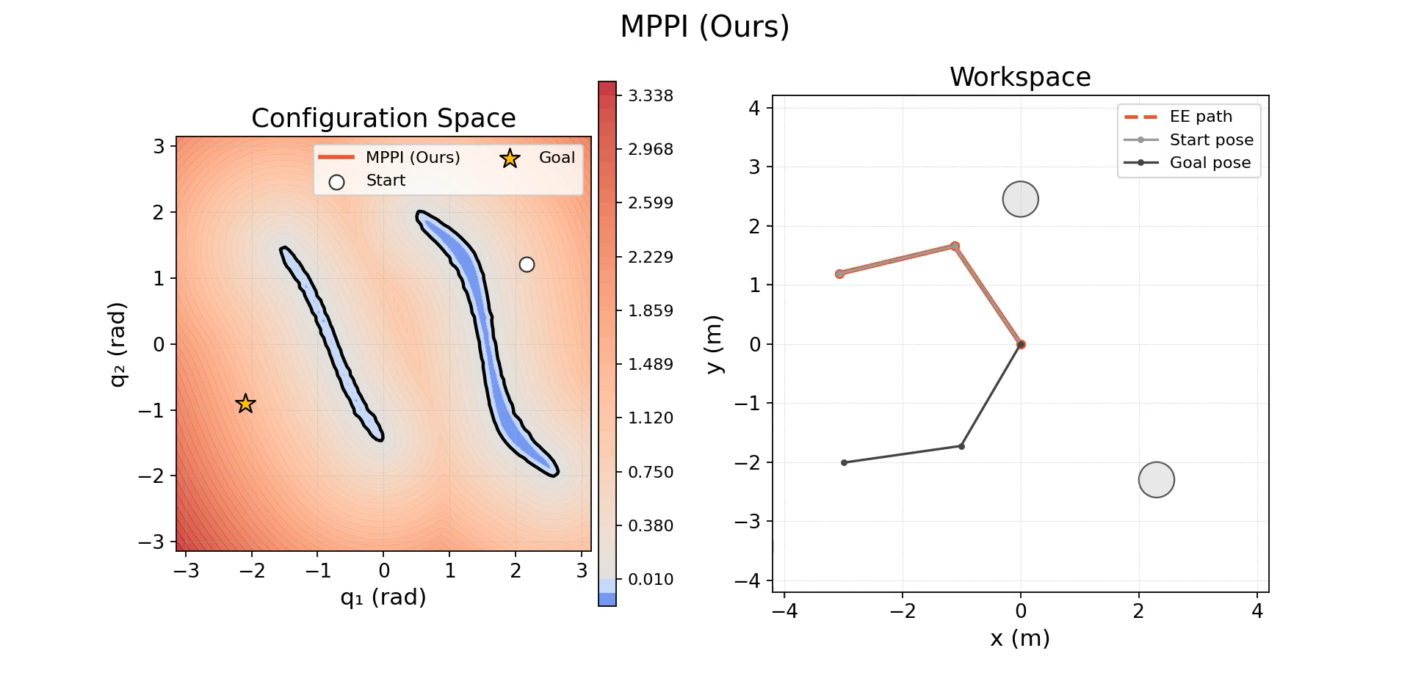
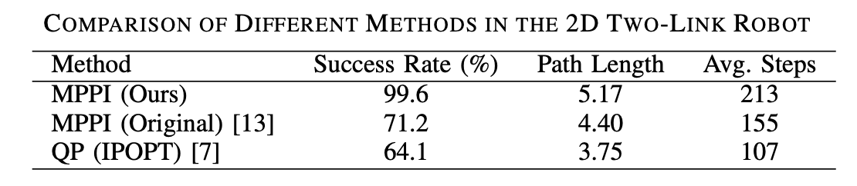
Experimental (2-DoF link robot)
CDF-MPPI
Our CDF-based MPPI reach the highest success rate and smooth path.
Notes:
CDF is a method for directly constructing a distance field in the configuration space. It provides smooth gradients and fast computation, allowing us to efficiently obtain the minimum distance between a point in the joint space and obstacles within that space.

Slide 14
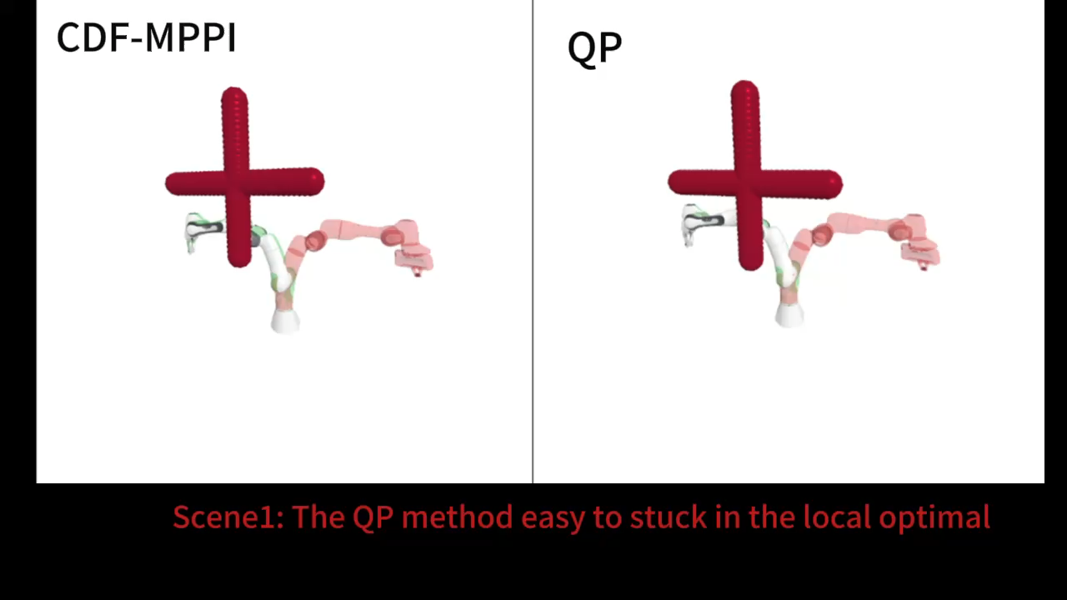
Experimental (7-DoF frank robot)
Scene 1: The QP method easy to stuck in the local optimal.
Notes:
CDF is a method for directly constructing a distance field in the configuration space. It provides smooth gradients and fast computation, allowing us to efficiently obtain the minimum distance between a point in the joint space and obstacles within that space.

Slide 15
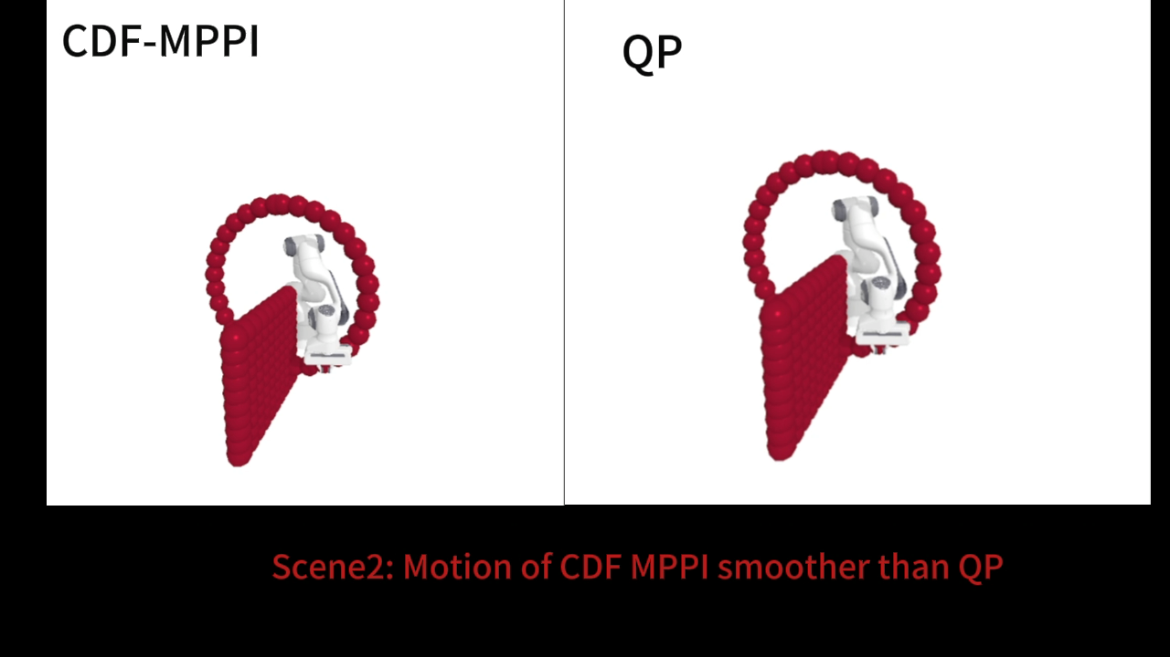
Experimental (7-DoF frank robot)
Scene 2: The motion of CDF-MPPI is smoother than QP.
Notes:
CDF is a method for directly constructing a distance field in the configuration space. It provides smooth gradients and fast computation, allowing us to efficiently obtain the minimum distance between a point in the joint space and obstacles within that space.

Slide 16
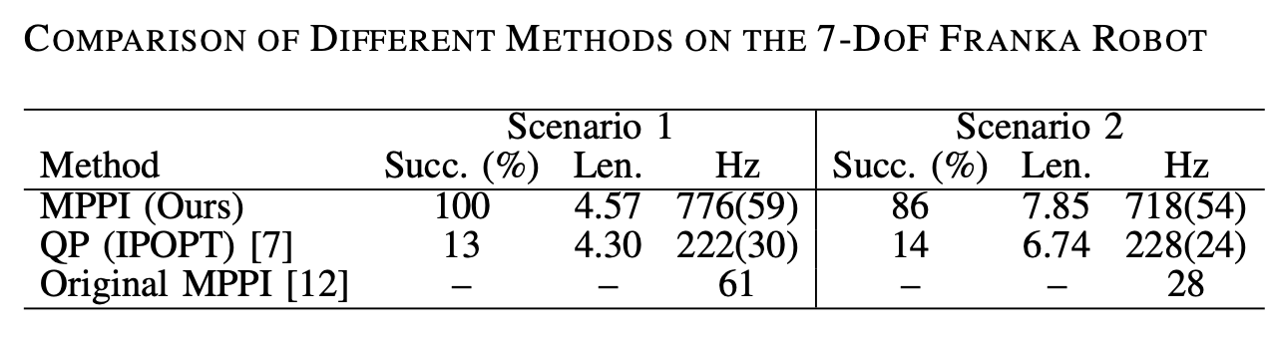
Experimental (7-DoF frank robot)
The original MPPI focuses on the end-effector space, so direct navigation in the configuration space tends to have poor convergence. Here, we only compare our method with the optimization-based approach in success rate.
Scene 1: Same start and goal configurations with moving obstacles. Scene 2: Same obstacle layout with randomized start and goal configurations.
Our CDF-based MPPI achieves both high control frequency and near-perfect success rates
Notes:
CDF is a method for directly constructing a distance field in the configuration space. It provides smooth gradients and fast computation, allowing us to efficiently obtain the minimum distance between a point in the joint space and obstacles within that space.

Slide 17
Conclusion
Proposed a CDF + One-step MPPI approach for configuration-space motion planning
Unified goal attraction and obstacle avoidance using an angle-based cost function
Significantly reduced computation, achieving >750 Hz control frequency
Achieved high success rates in both 2D and 7-DOF scenarios, outperforming QP and original MPPI
Future Work
Trying the real experimental in UR3e
Improe the accuracy of the CDF
Notes:
CDF is a method for directly constructing a distance field in the configuration space. It provides smooth gradients and fast computation, allowing us to efficiently obtain the minimum distance between a point in the joint space and obstacles within that space.

